Slide 1




UK NATIONAL RAIL PERFORMANCE 2024

Slide 2


Agenda
01
02
03
04
Meet the Team
Background
Business Question
Approach and Insights
05
Conclusion

Slide 3

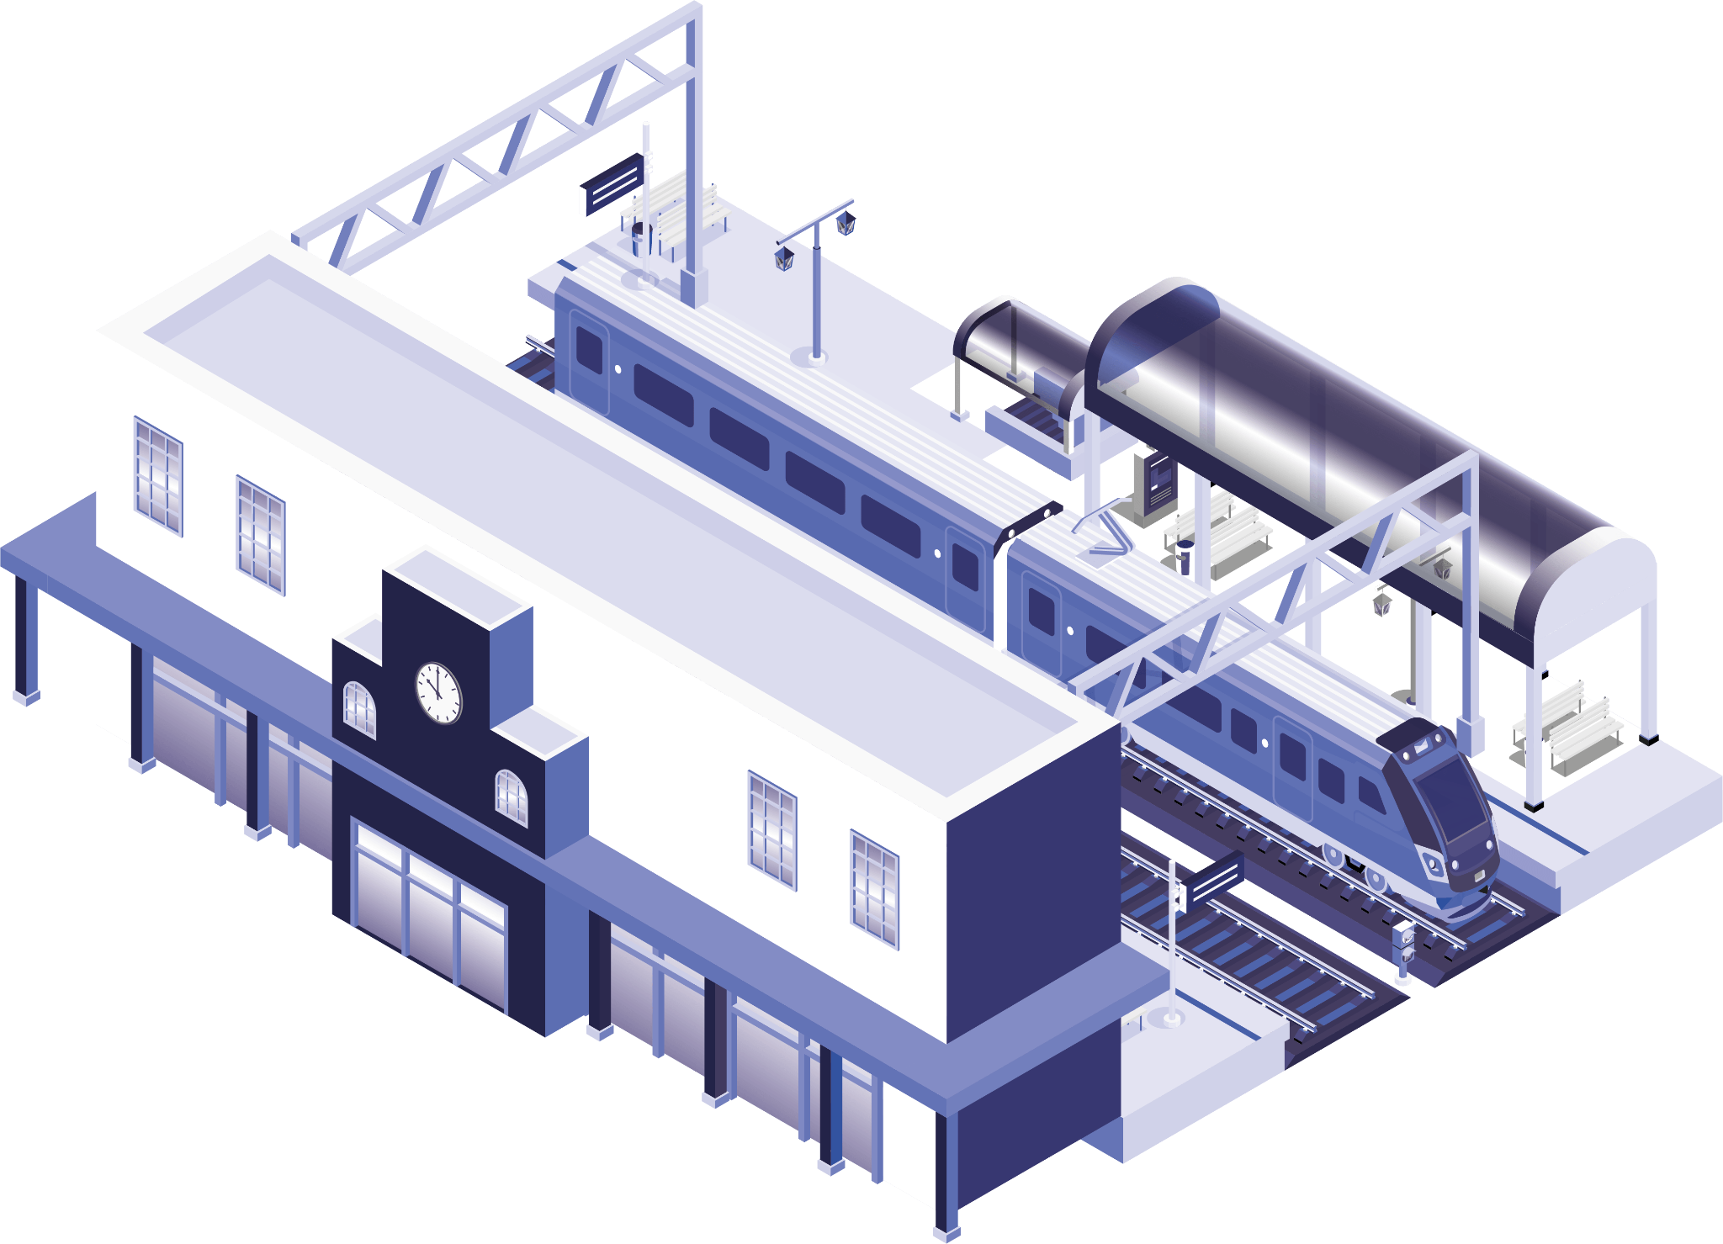
Meet the Team
Brian Levesque
Ilackkeya Bhavananthi
Osman Nayeem

Slide 4

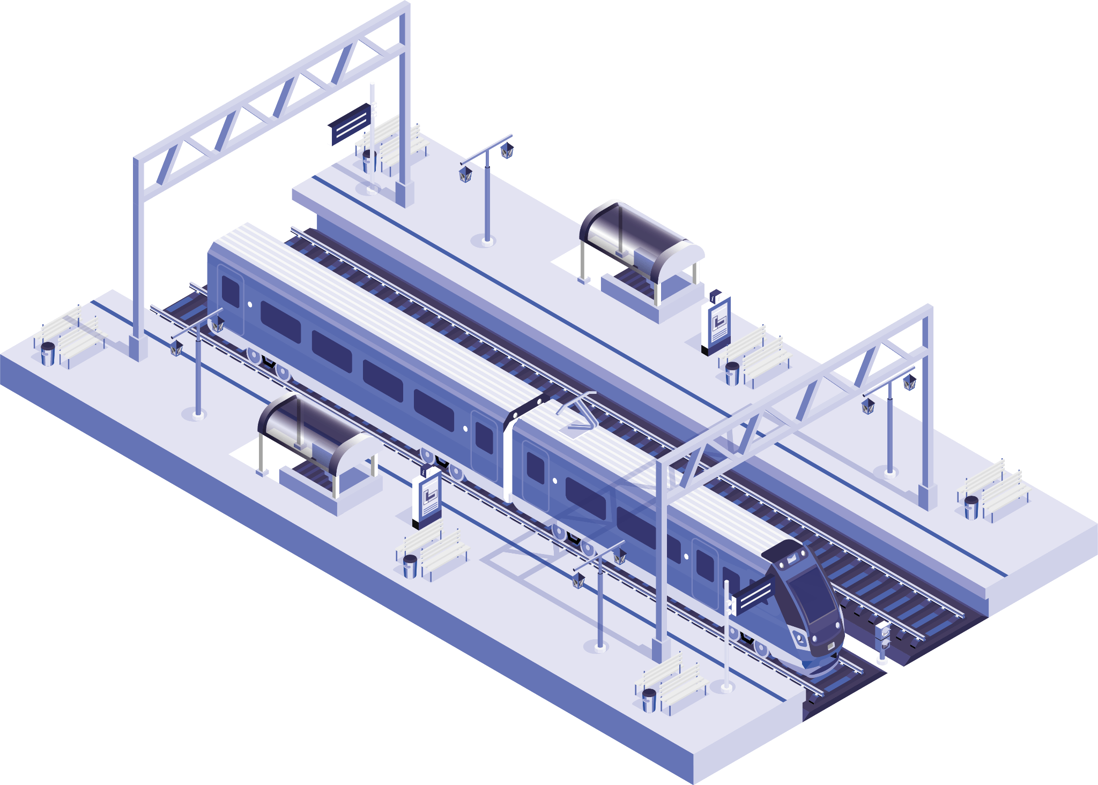
Background
The UK railway network serves around 2,500 stations in the UK.
Approximately 1.8 billion passenger journeys per year (pre-pandemic levels).
Managed by various train operating companies (TOCs) under franchises awarded by the government.
Source: ORR | Network Rail | National Rail

Slide 5

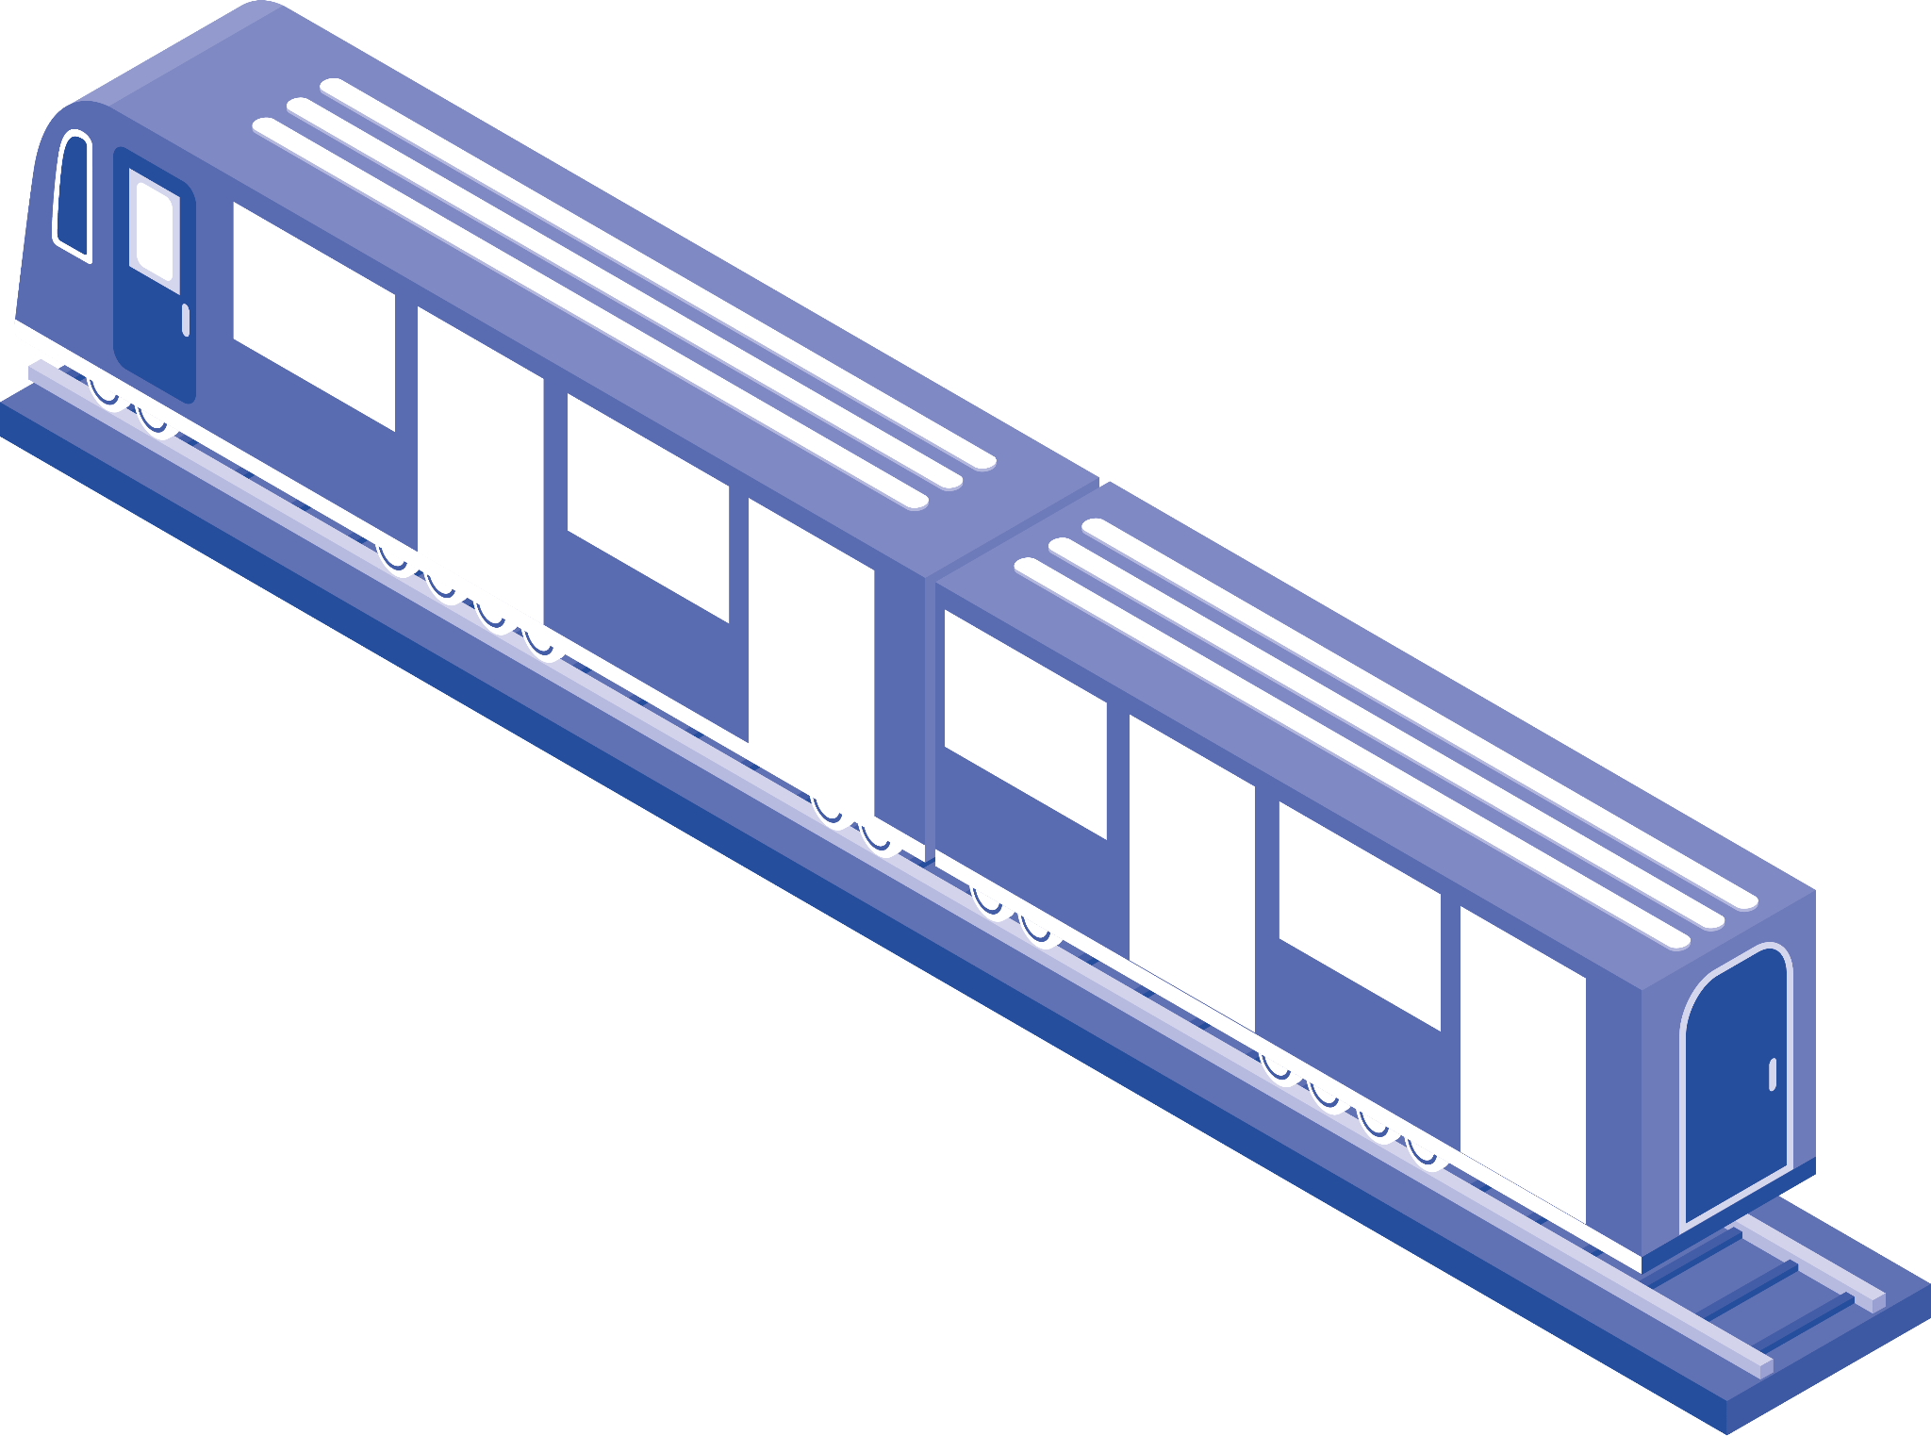
Business Question
Client : Current Board of UK National Railways
Objectives:
Schedule performance overview
Analyze Delay Compensation efficiency by TOCs
Build Delay prediction model

Slide 6

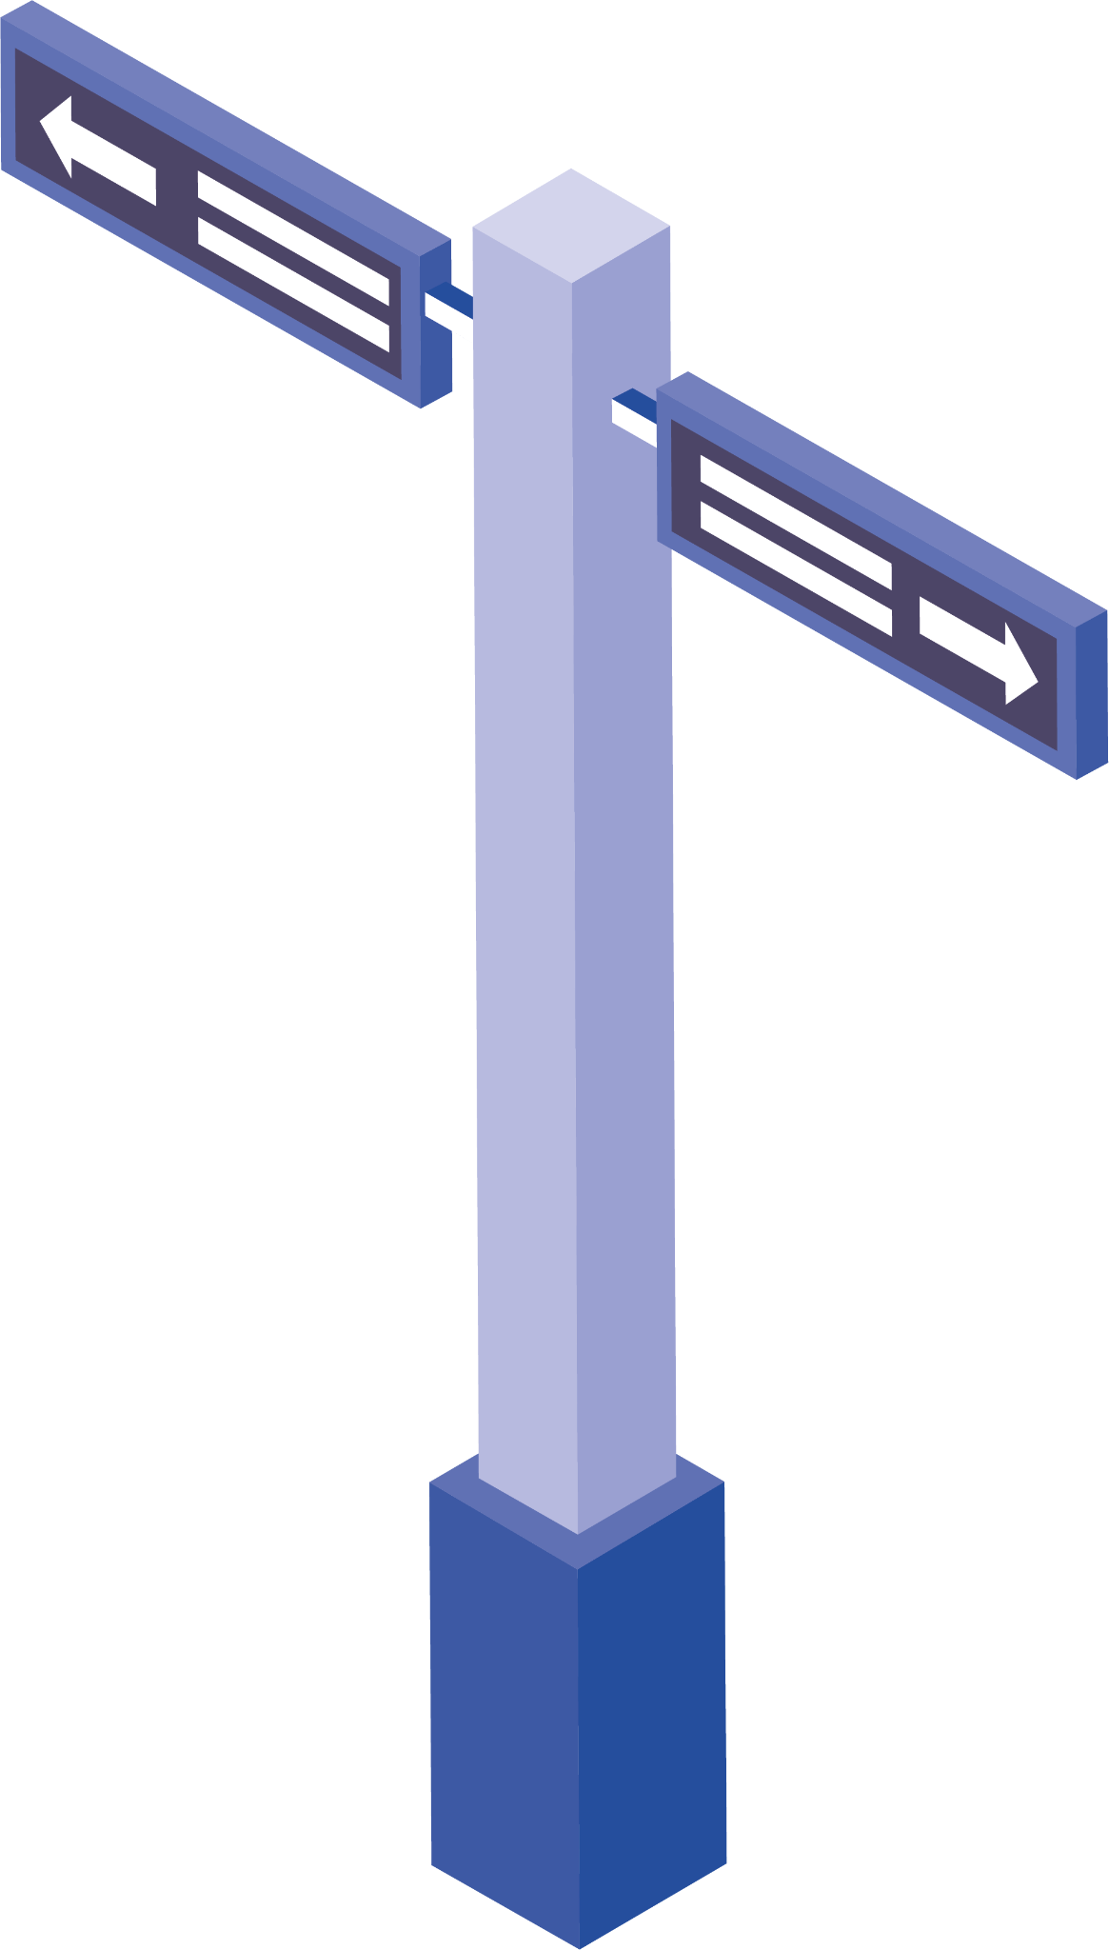
Approach
Where and How to get the data?
Source – National Rail Data Portal
1
6
Data Analysis
Build Data Pipeline
2
5
Data Cleaning
Data Collection
3
4
Load / Access Database

Slide 7
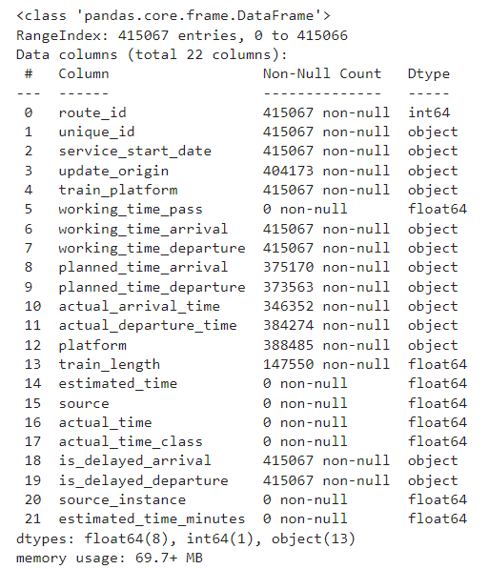
Approach
What is in our data?
Data Transformation:
Longitude, Latitude, Delayed Arrival/Departure Minutes. Origin and Destination
Data Enrichment (PowerBI):
Gathered Additional Data from Office of Rail and Road (ORR) - TOCs list, Delay Compensation claims and more

Slide 8
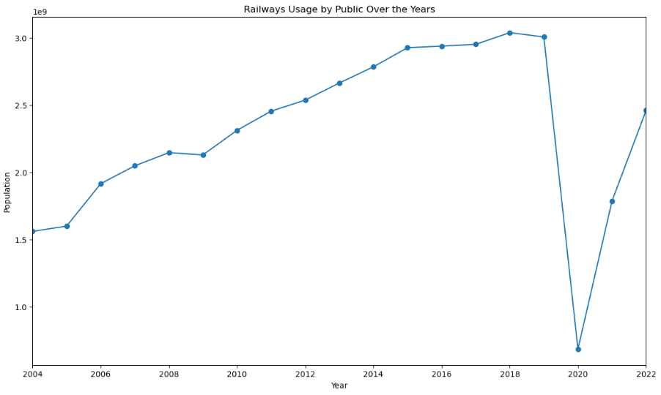
Insights
Public Usage Trend of UK Railways
Public usage trends shows a steady growth from 2004 - 2019, then falls sharply during the 2020 pandemic but is recovering gradually
Highlights the prominence of Railways as a means of transportation

Slide 9
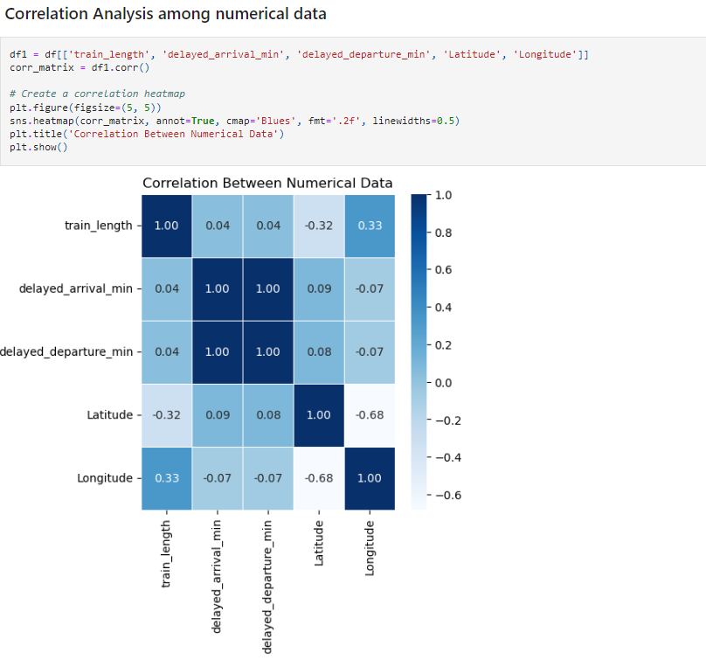
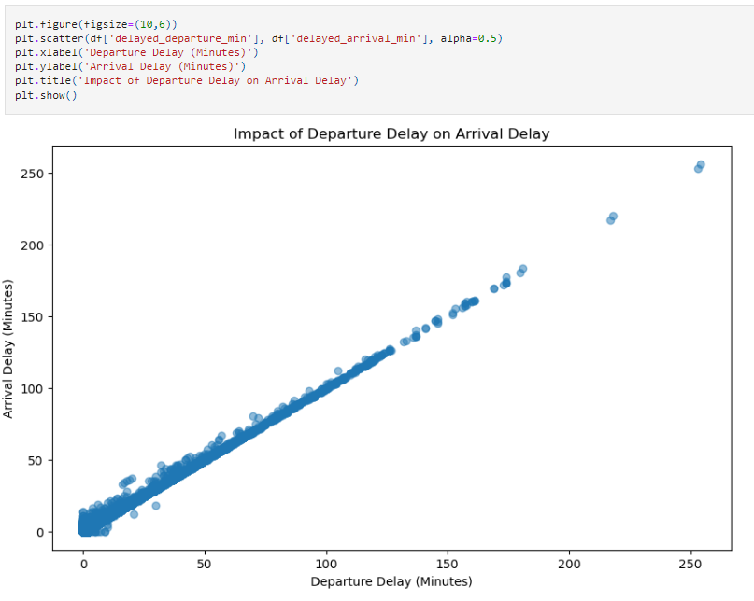
Insights
Correlation Analysis
Strong correlation of 1.00 suggests:
Departure delay influences Arrival Delay

Slide 10
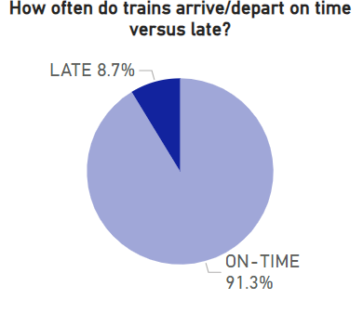
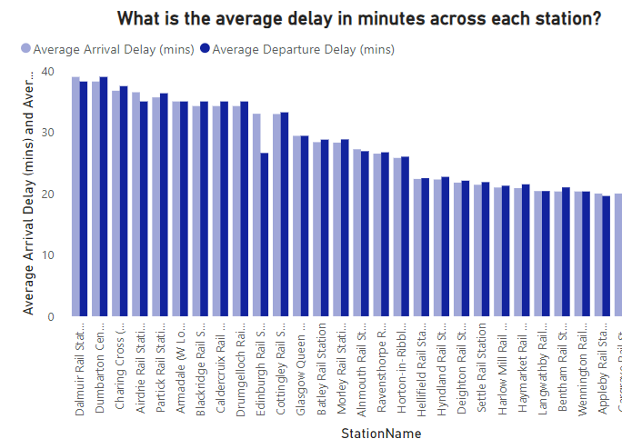
Insights
Schedule performance overview
Trains are delayed around 8.7% of the time in a day
Maximum Average delay of 39 mins is observed at Dalmuir Rail Station

Slide 11
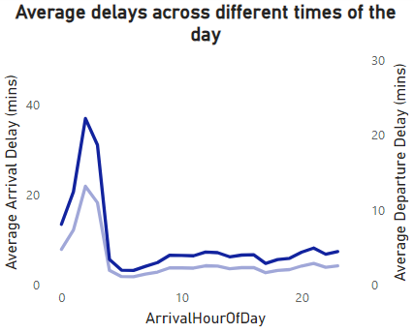
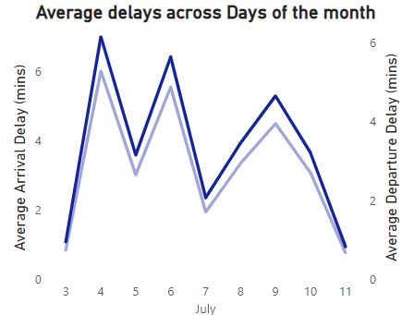
Insights
Schedule performance overview
Peak Average delay happens between 2 AM and 3 AM in a day
Peak Average Delays occurs on alternate days of the week

Slide 12
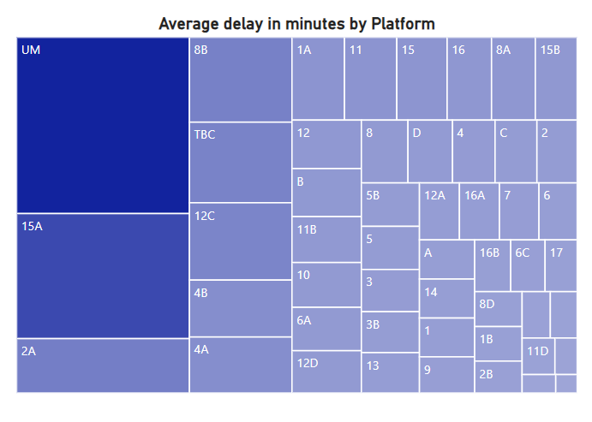
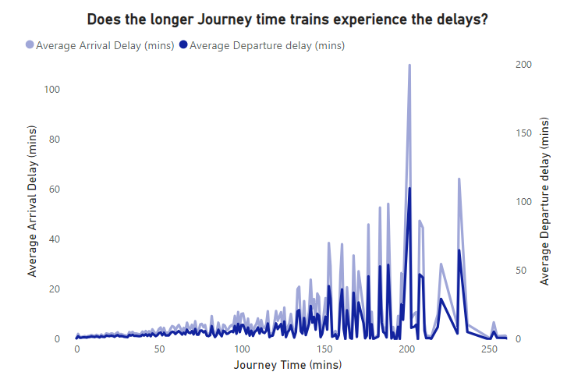
Insights
Schedule performance overview
Platforms UM at Chester-Le-Street and 15A at Leeds Rail station are experiencing high traffic with an average delay over 34 minutes.
Trains with journey longer than 125 mins, experience delay >25 mins
Notes:
Peak average delay of 109 minutes for 200 minute journey to travel from Cambridge to Tottenham.

Slide 13
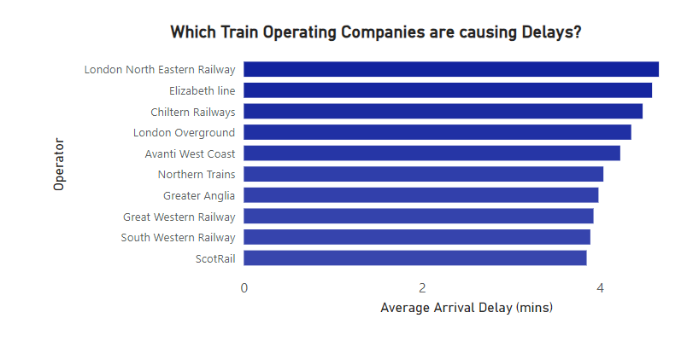
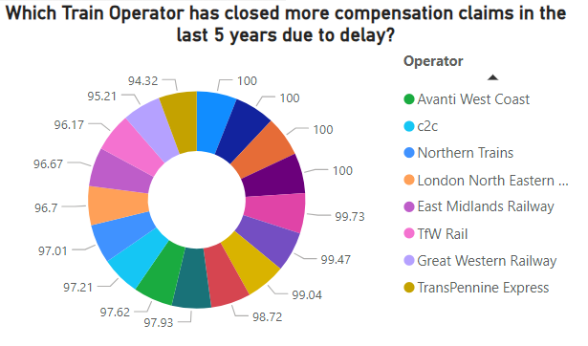
Insights
Delay Compensation efficiency by TOCs
London North Eastern Railway TOC’s trains are the most delayed on an average.
96.7% of delay compensation claims are closed ensuring customer satisfaction and user experience
Non-uniform delay compensation policies by TOCs hinder assessing customer service efficiency and improving user experience.

Slide 14
Approach and Insights
Delay prediction model
Built a model to predict any delay in a scheduled train.
Train Length
Operator
Journey Time
Obtained an accuracy of 91.25% for the model
Biggest Predictor for delay is Journey Time.
Longer Journey Times More Delays
Operator C2C was a big predictor in no delay
Factors | Coefficients
Journey Time | 0.09
Operator c2c | -0.18
Influencing Operators (Strong effect) | 0.03
Influencing Operators (Low/No effect) | -0.05
Train Length | 0.01

Slide 15
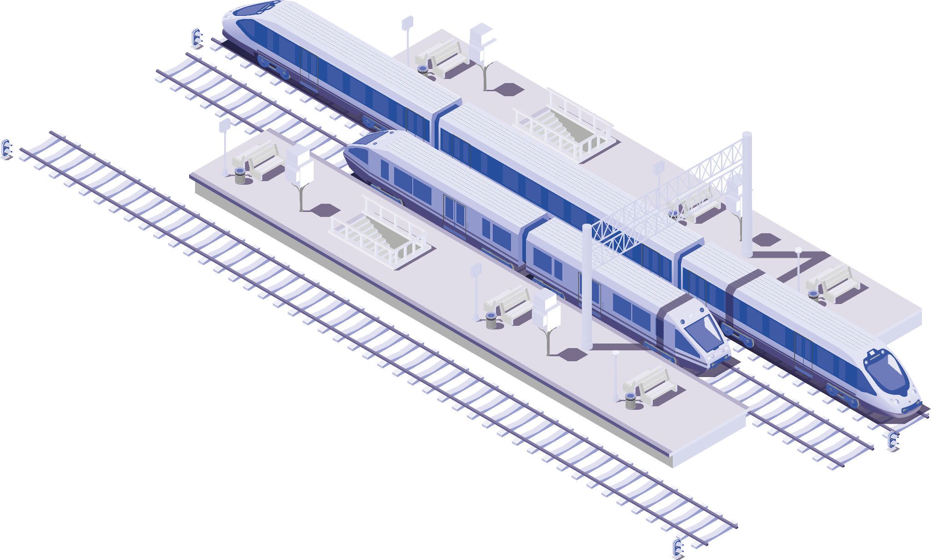
05
Key Insights
Public Usage of UK Railways: 3 billion (2019)
Delay metrics:
Overall delay: 8.7% of the time in a day
Day: around 39 minutes between 2 AM and 3 AM in the early morning
Week: Alternate days
Most Delayed TOC: London North Eastern Railway
Influential Factor in predicting the delay: Journey Time

Slide 16
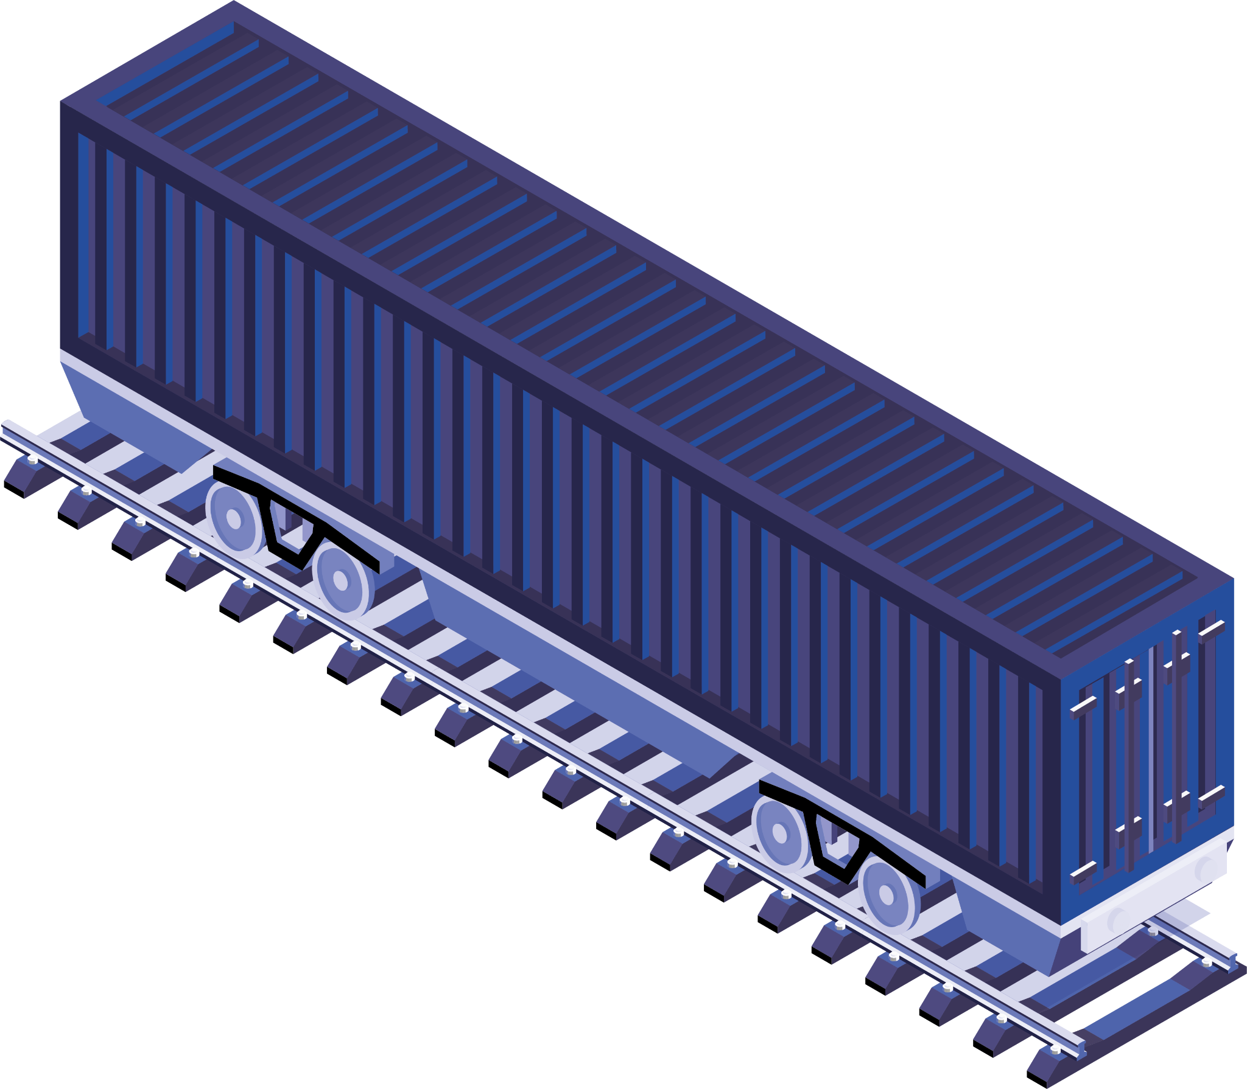
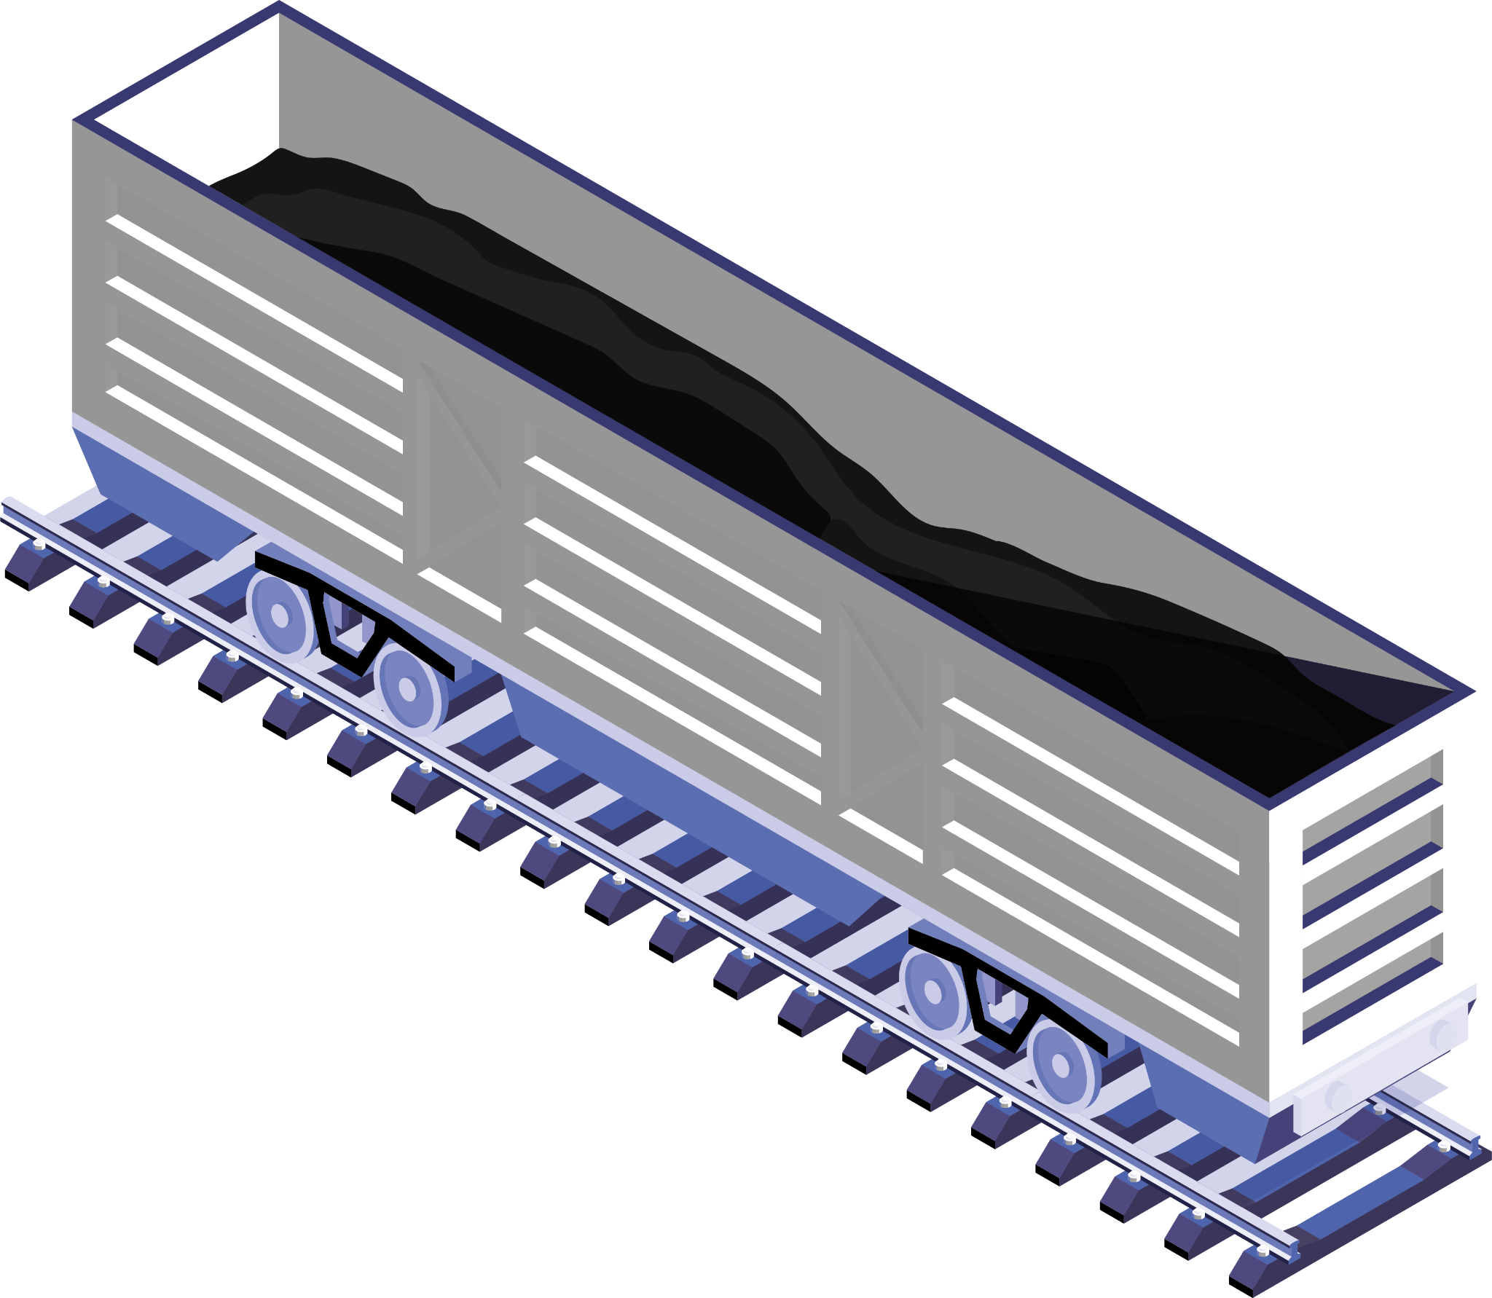
Acknowledgement
James Lee-Meredith, Instructor
Dylan Gleason, Teaching Assistant
William Westley, Program Manager
Grand Circus Team

Slide 17

Thank you!

